Slide 1
Competitive Programming
09 Dec. 2022
Andrei Novikov

Slide 2
Practice – Challenge #1
Resource: Competitive Programming 3
10034 Freckles – Link to the Task.

Slide 3
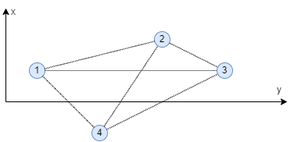
Practice – Challenge #1 – Approach
Consider input points as nodes.
Apply Euclidean metric to find weight of each edge.
Calculate minimum distance during creating MST.
Use Disjoint Sets to produce optimal solution.
MST + Disjoint Sets

Slide 4
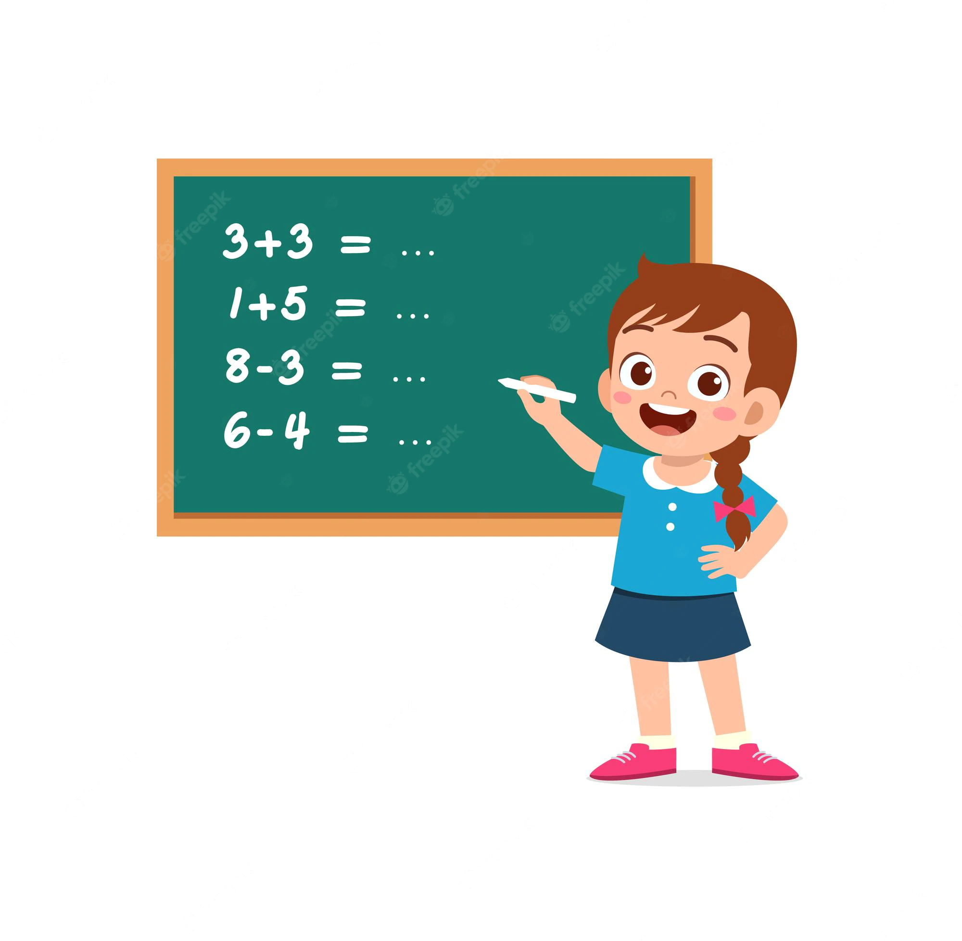
Practice – Challenge #1 – Coding
Implement the Solution.

Slide 5
Practice – Challenge #1 – Solution
Resource: Competitive Programming 3
10034 Freckles – Link to the Task.
Solution – Link to the Solution.
Approach: MST + Disjoint Sets.

Slide 6
Single – Source Shortest Path, SSSP
The task is to find the shortest distance to all nodes in the graph from the specific one.
BFS – is acceptable only if graph is unweighted.
What to do if graph is weighted?

Slide 7
Single – Source Shortest Path, SSSP
The task is to find the shortest distance to all nodes in the graph from the specific one.
If graph unweighted, we can use BFS for to do that.
Usually such tasks are very strongly masked under a creative description.

Slide 8

Single – Source Shortest Path, SSSP
It is time to turn page in our book. And now we are on the chapter 4.4 – Competitive Programming 3.

Slide 9
Single – Source Shortest Path, SSSP
Topic: Shortest Path in Unweighted Graph.
Source: Competitive Programming 3.
UVa 11101 – Mall Mania – Link to the Task.

Slide 10
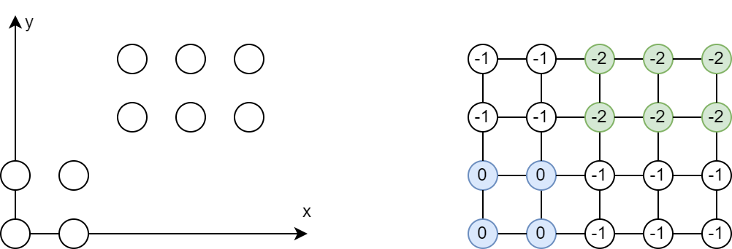
Practice – Challenge #2 – Approach

Slide 11
Practice – Challenge #2 – Approach
Consider input points as nodes.
Consider roads as edges defined by Manhattan metric.
Add to the queue nodes from the mall #1.
Run BFS until nodes from the mall #2 are not reached.
As a node visited marker, use the amount of steps that was performed to calculate min distance from mall #1 to mall #2.

Slide 12
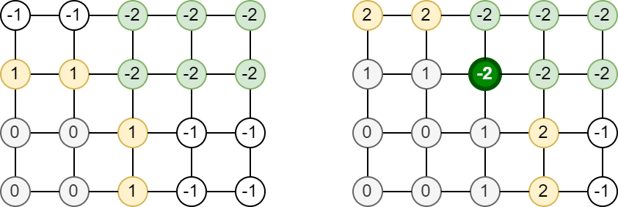
Practice – Challenge #2 – Approach

Slide 13
UVa 11101 – Mall Mania
Implement the solution.

Slide 14
UVa 11101 – Mall Mania
Topic: Shortest Path in Unweighted Graph.
Source: Competitive Programming 3.
UVa 11101 – Mall Mania – Link to the Task.
Solution – Link to the Solution.

Slide 15
Hometask
Resource: Competitive Programming 3
Theory:
4.4.3 SSSP on Weighted Graph
4.4.4 SSSP on Graph with Negative Weight Cycle
Practice:
UVa 11367 – Full Tank?
UVa 00929 – Number Maze

Slide 16




Where to Practice
LeetCode [link]
HackerRank [link]
Kattis [link]
TopCoder [link]
Other Resources

